Slide 1


Perspectives on Coastal User Needs,
Products and Observing Systems
Paul M. DiGiacomo
Chief, Satellite Oceanography
& Climatology Division
NOAA-NESDIS Center for Satellite
Applications and Research (STAR)
NOAA-NESDIS Cooperative Research Program
10th Annual Science Symposium: “Satellites and Society”
NOAA-CREST Center, City College of New York
9 September 2014

Slide 2
Needs, Issues, Gaps and Challenges
Users require timely, accurate, consistent and fit for purpose data provided at regular intervals
over sustained periods that adequately resolve the processes, phenomena & characteristics of
interest for inland water & coastal ecosystem monitoring and management.
The IGOS Coastal Theme Report (IGOS, 2006) and the PICO Coastal GOOS Report (IOC, 2012)
provide a thorough overview of user needs, requirements and gaps from a from a broad coastal
observing (satellite, in situ and modeling) perspective.
Satellite ocean color observations were identified in the GEOSS Water Quality Remote Sensing
Workshop (2007) as having the greatest value utility for water quality applications, but a host of
supporting geophysical observations (e.g., surface temps, winds) are also strongly desired.
Aside from issues of data quality and access, a key concern amongst users is ensuring continuity
of consistent data, both from in situ & satellite sources. There are numerous systems that have
proven valuable, esp. moderate resolution ocean color (e.g., MERIS). Potential continuity is
available (e.g., Sentinel-3/OLCI) but data needs to be made readily available to diverse users.
That said, existing/planned satellite observing capabilities potentially provide inadequate spatial,
temporal and/or spectral resolution of important biological and geophysical parameters for inland
water and coastal ecosystem applications, with some key measurements not made at all from
space (e.g. estimates of river discharge).
Further, additional efforts are required to support application development, bringing together data
providers and users in coordinated, integrated activities (especially across the land-sea interface).

Slide 3
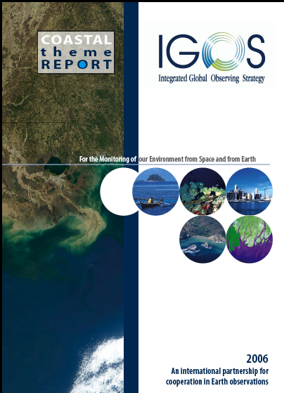
IGOS Coastal Theme Report: Coastal Observing Priorities
IGOS Coastal Theme Report, 2006

Slide 4
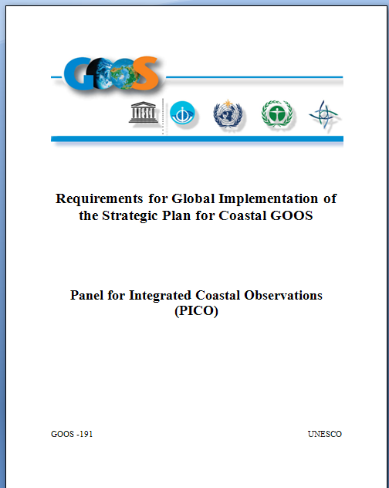
Requirements for Global Implementation of the Strategic Plan for Coastal GOOS
Priority Phenomena of Interest
  Coastal Eutrophication & Hypoxia
Human Exposure to Waterborne Pathogens
Toxic Algal Blooms
Habitat Loss & Fragmentation
Vulnerability to Coastal Flooding
Ocean Warming & Acidification
Food Security
The “PICO” Coastal GOOS Plan, 2012
Available at: http://www.ioc-goos.org

Slide 5
Priority Phenomena of Interest & Associated Indicators
Phenomenon of Interest
Key Indicators of Ecosystem States
Coastal Eutrophication & Hypoxia
Phytoplankton biomass fields
Dissolved oxygen fields
Human Exposure to Waterborne Pathogens
Distribution & abundance of waterborne pathogens
Harmful Algal Blooms
Distribution & abundance of toxic phytoplankton species
Habitat Loss & Modification
Extent & condition of biologically structured habitats
Vulnerability to coastal flooding
Extent & condition of habitat buffers to flooding
Ocean acidification
Extent & condition of coral reefs
Abundance of calcareous plankton
Food Security
Abundance of harvestable finfish & shellfish stocks
Notes:
After much deliberation & consultation priority PoI and associated key indicators of states were determined. Most are relevant to Estuaries.

Slide 6
ESSENTIAL ECOSYSTEM STATE VARIABLES
Geophysical
Chemical
Biological
Biophysical
Temperature | Dissolved N, P, Si | Chlorophyll | Water leaving radiances
Salinity | Dissolved O₂ | Toxic phytoplankton | Downwelling irradiance
Current velocity | pH | Calcareous plankton
Surface wave height & direction | pCO₂ | Copepod indicator species
Absolute sea level | Total alkalinity | Enteric bacteria
Shoreline position | Aragonite saturation state | Extent of biologically structured benthic habitats
Bathymetry | Colored dissolved organic matter | Species diversity
Sea surface roughness |  | Exploitable fish stocks
Total suspended matter |  | Bycatch
 |  | Large pelagic predators
Notes:
Then, based on the data requirements for each end-to-end solution, essential ecosystem state variable to be monitored were identified. These included geophysical, chemical, biological & biophysical state variables.

Slide 7
NOAA Ocean and Coastal Ecosystem Interests & Observing Needs
NOAA helps to manage society’s use of ocean and coastal ecosystems, sustain
natural resources and ecosystem health and services, and protect public health
under several legislative & executive mandates, e.g.,
The Coastal Zone Management Act
Coral Reef Protection Executive Order/Coral Reef Conservation Act
The Clean Water Act
The Harmful Algal Bloom and Hypoxia Research & Control Act
The Magnuson-Stevens Fishery Conservation and Management
Reauthorization Act
The Marine Mammal Protection Act
The National Coastal Monitoring Act
The National Marine Sanctuaries Act
Satellite data (e.g., ocean color and SST) and derived products are invaluable
sources of information to help address these mandates and other important
coastal management as well as research and other needs.
Many challenges as well as opportunities exist in terms of bringing together data/
information providers and users in this context.

Slide 8
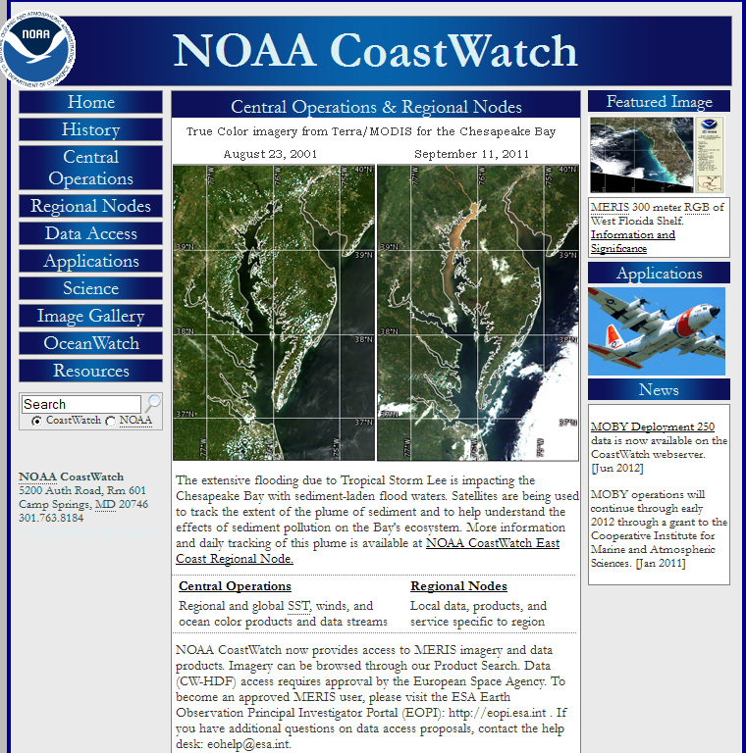
Addressing Coastal User Data and Information Needs
In response to user requests, satellite
data & products are initially generated
by NOAA/NESDIS on an experimental
basis, and as appropriate, ultimately
transitioned into operations
Data sets include: SST, ocean color et al.;
various derived products & applications
Coverage is regional (e.g., Chesapeake
Bay, Great Lakes) through global
Distribution mechanisms include:
  NOAA CoastWatch
  http://coastwatch.noaa.gov/
  NOAA Coral Reef Watch
http://coralreefwatch.noaa.gov/

Slide 9
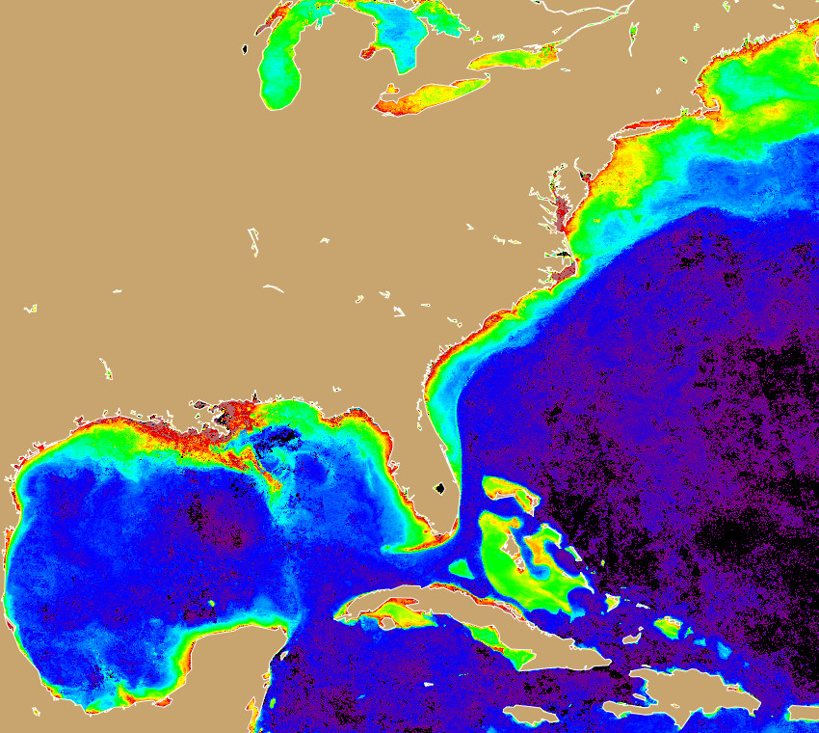
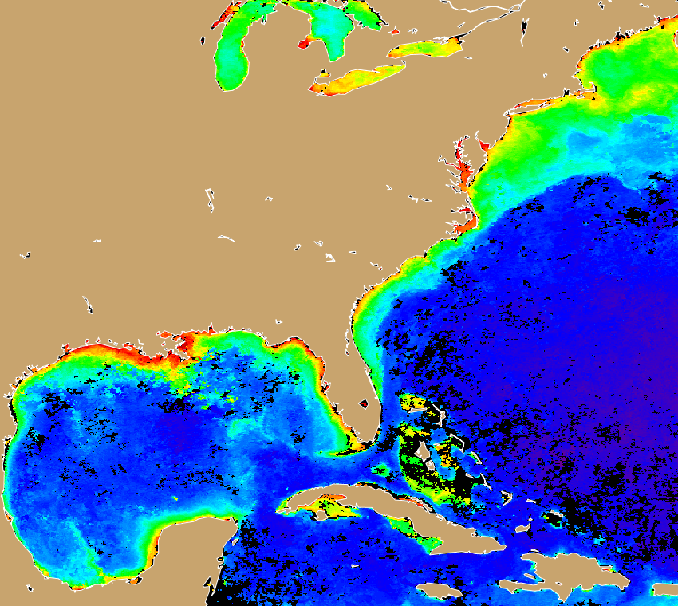

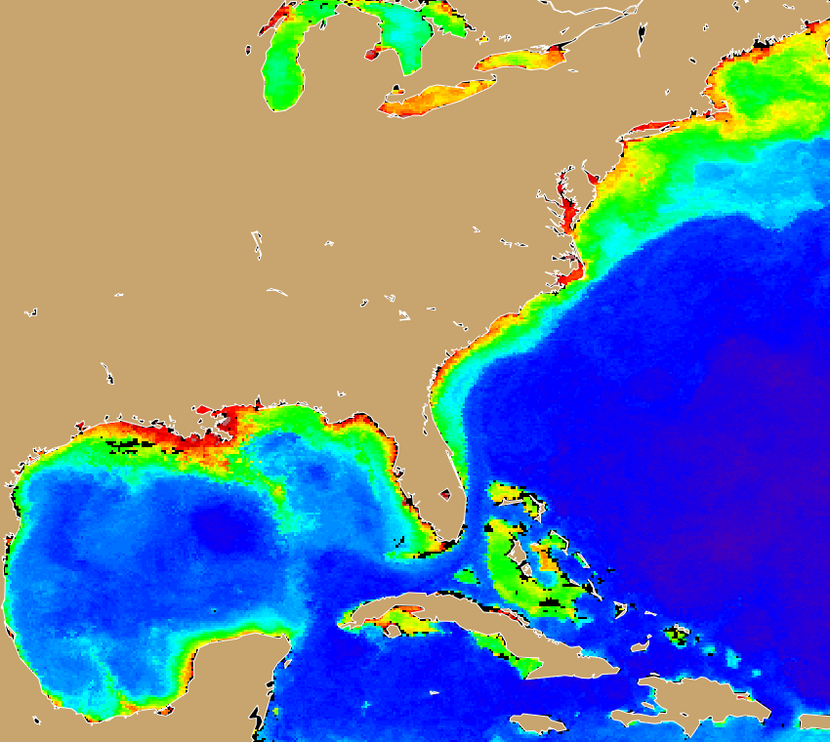
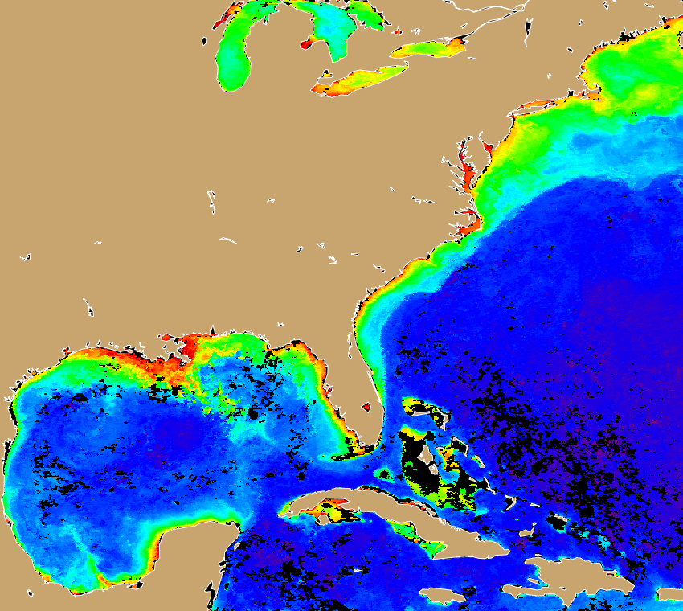
VIIRS Ocean Color Products
OC3 @ IDPS
L2GEN @ NASA
NOAA
MSL12
MODIS
Monthly
Chlorophyll
July 2013

Slide 10
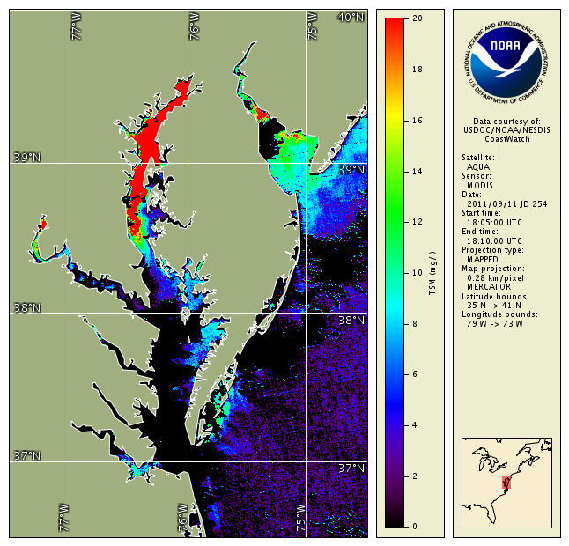
Satellite Monitoring of Post-Storm Coastal Sediment Plumes
Sediment plume in Chesapeake Bay following 2011’s Tropical Storm Lee
Satellites can measure concentration of sediment in the surface water
Red indicates high sediment concentration as a result of storm runoff from land

Slide 11
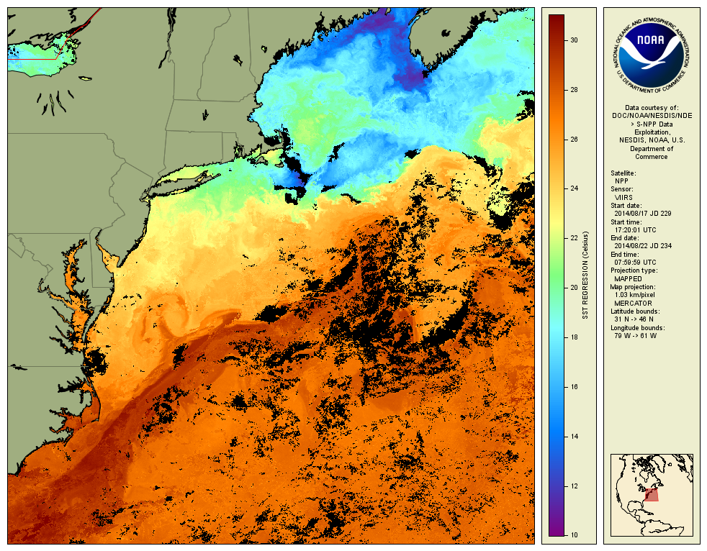
Gulf Stream
VIIRS ACSPO SST 5-day Composite

Slide 12
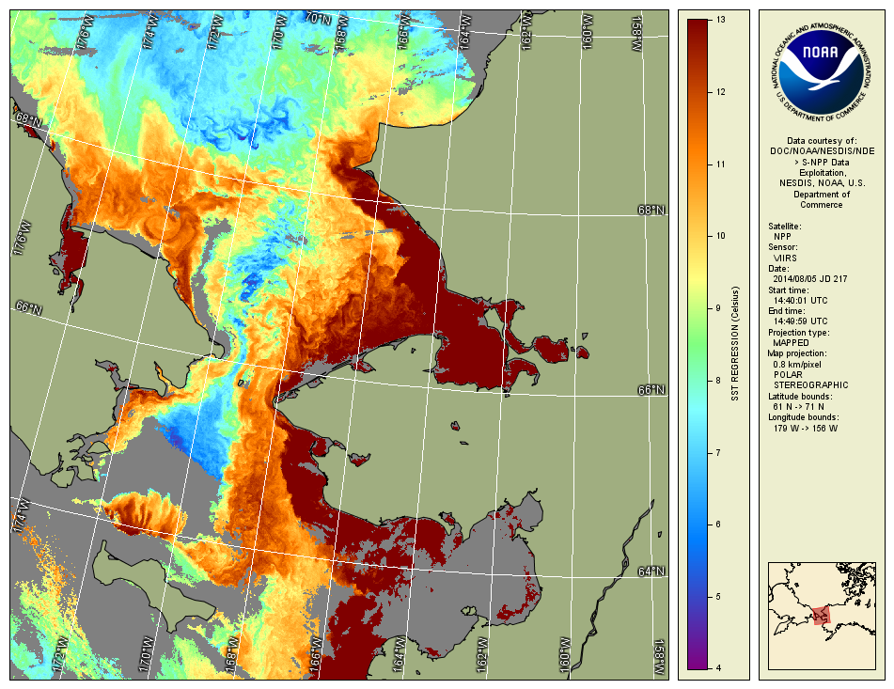
Bering Strait
VIIRS ACSPO SST

Slide 13
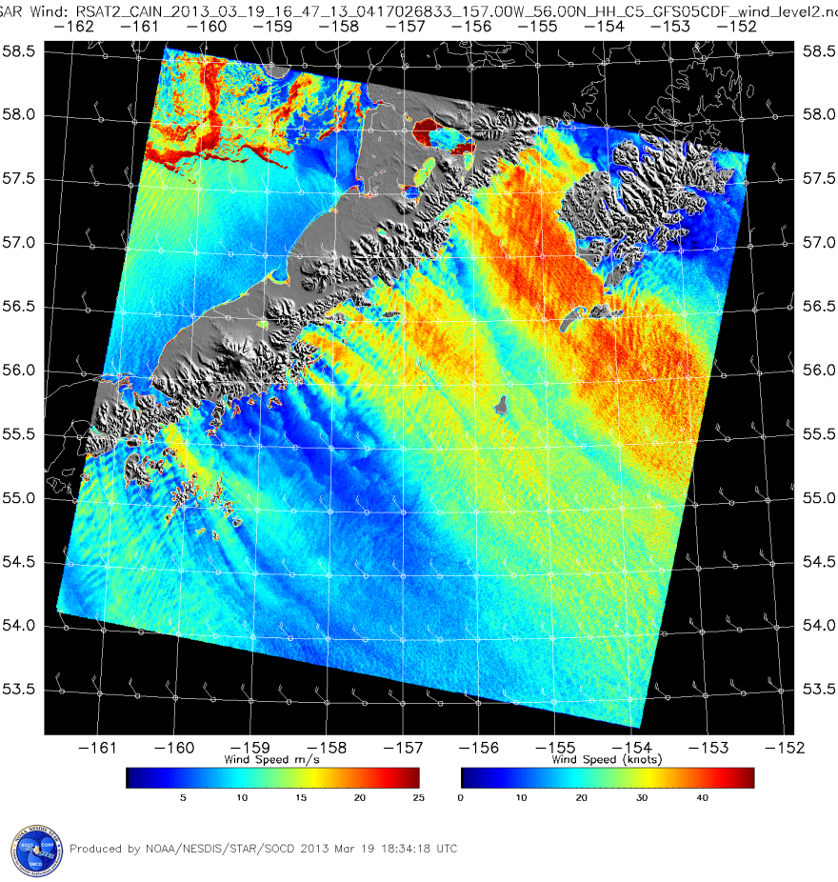
Operational SAR High-Resolution Coastal Wind Product
The NESDIS Satellite Products and Services Review Board (SPSRB) at their March 20, 2013 meeting decided that the synthetic aperture radar (SAR) High-Resolution Coastal Wind Product was ready for operations. Operational production began in May 2013. This product had been produced experimentally since 1999. Formal operational implementation activities began in 2008 per request by the NWS Alaska Region.
SAR high-resolution coastal wind product generated from a RADARSAT-2 image of Kodiak Island and the Alaska Peninsula.
This image shows highly variable wind patterns influenced by the rugged coastal topography of Alaska. The features in the
upper left hand corner of the image are not wind, but ice patterns in Bristol Bay, Alaska. The SAR Image is from March 19, 2013 at 16:47 UT. The wind barbs in the image are winds from the NWS Global Forecast System.
Although currently SAR data are only available from the commercial RADARSAT-2 satellite through data purchased
by/for the National Ice Center, the fully operational Sentinel-1 satellite with assumed full/free/open data policy was
launched in April 2014 by ESA and will provide much larger quantities of SAR image data for this operational product.
(Courtesy of W. Pichel) Sponsor: ORS, Polar PSDI

Slide 14
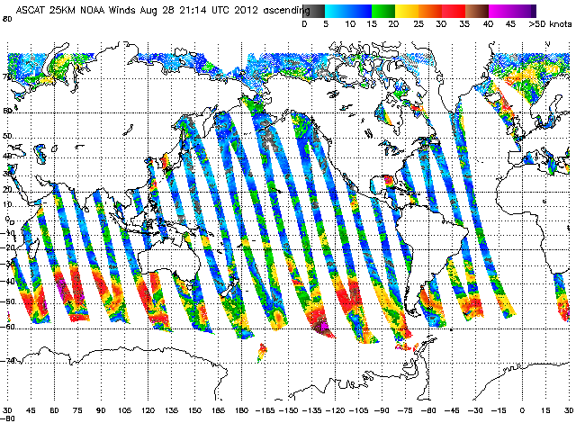
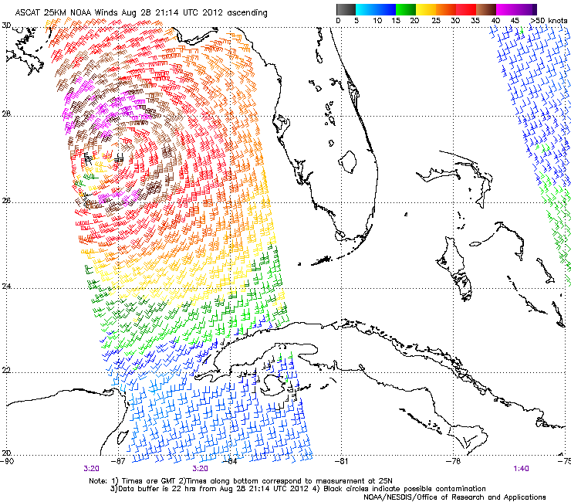
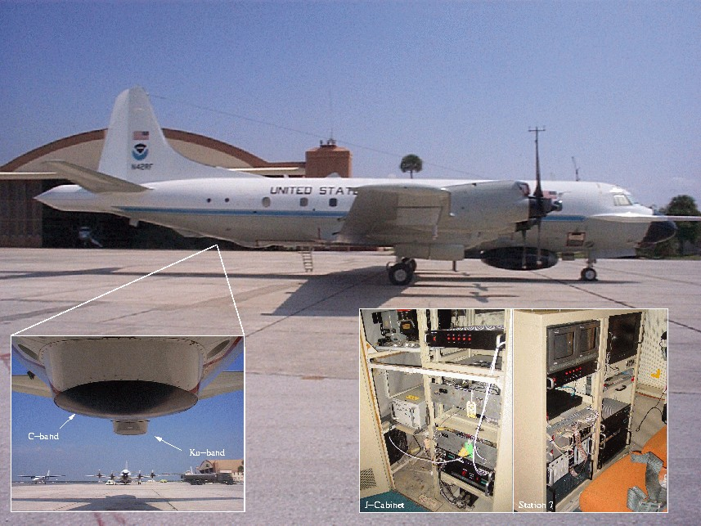
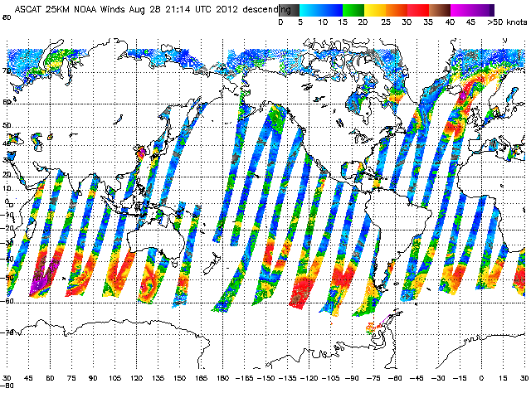
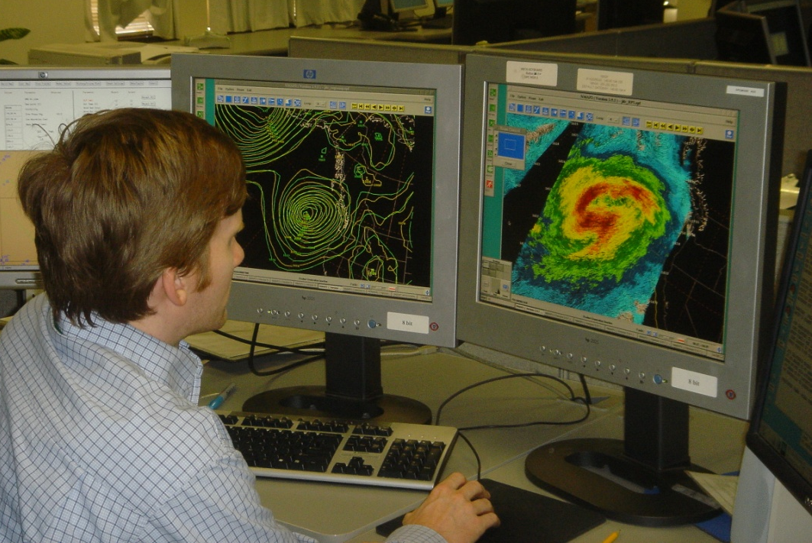
Satellite Ocean Surface Vector Winds
ASCAT Daily Coverage Example
OSVW data supports wind and wave warning and forecasting
ASCAT data from EUMETSAT operational at NOAA
OSCAT data from ISRO was in operational demonstration phase prior to its failure in 2014
NOAA P-3 used to fly a profiling scatterometer system (IWRAP) for validation and improvement of satellite algorithms in tropical (hurricanes) and extratropical cyclone conditions
Hurricane
Isaac
Goal: Provide the best possible product and training to end users
NOAA Satellite Ocean Surface Winds Science Team
http://manati.star.nesdis.noaa.gov/

Slide 15
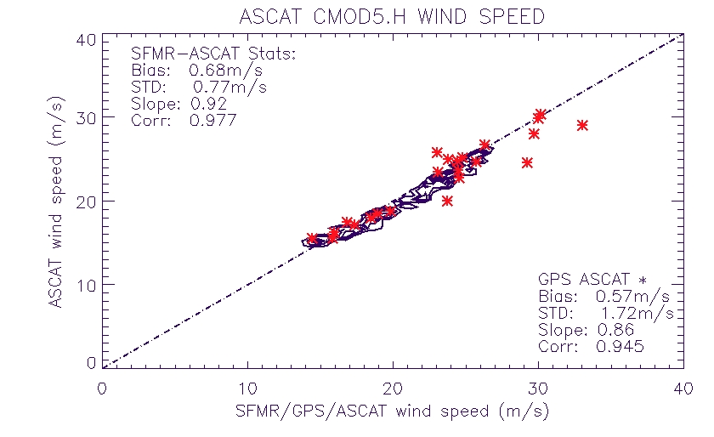
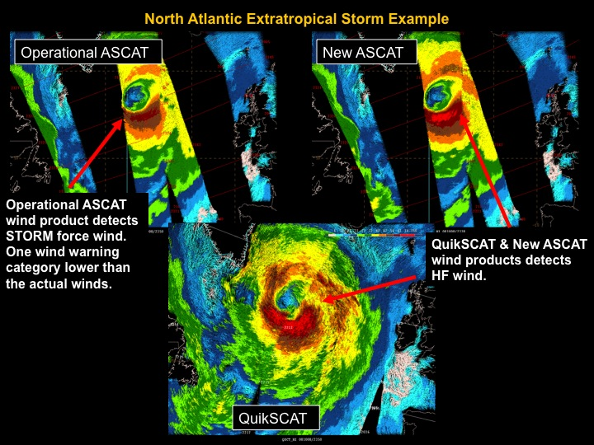
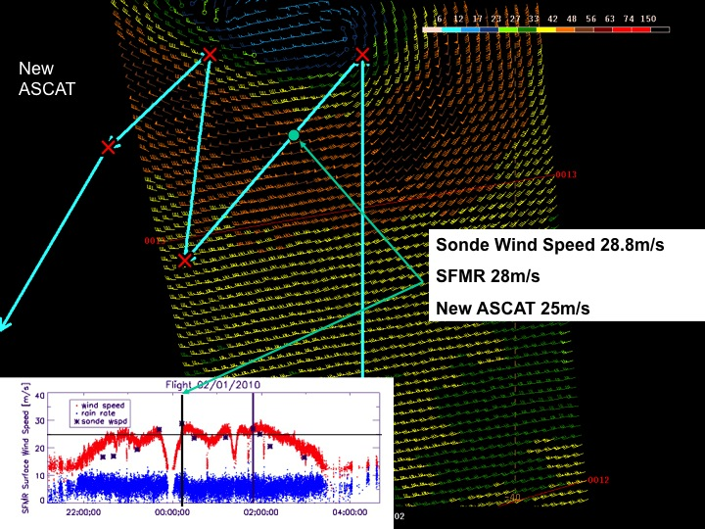
ASCAT High Wind Speed Retrieval Improvement
ASCAT high wind speed improvements developed utilizing aircraft and satellite data
New ASCAT winds versus SFMR and GPS dropsonde winds
Hurricane force wind observations with NOAA’s QuikSCAT and original and new ASCAT wind products
Flight track overlaid on ASCAT swath

Slide 16
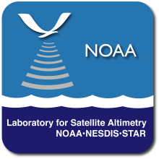
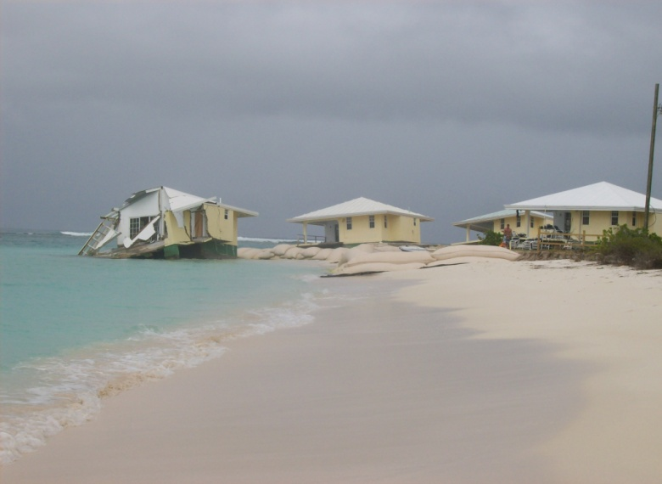
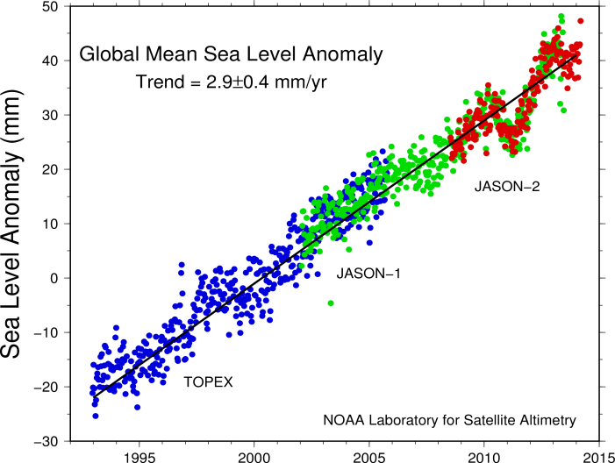
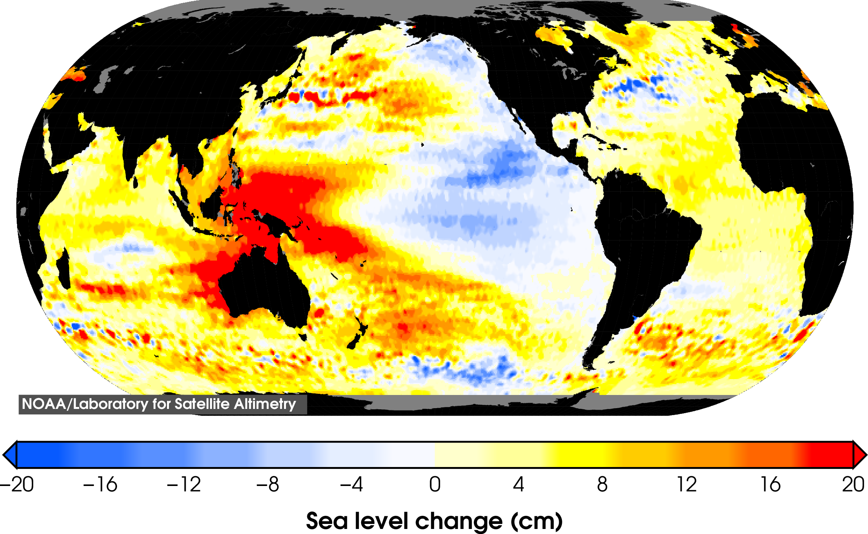
Global & Regional Sea Level Rise
Jason 22+ Year Global Mean Trend
--22+ year record shows mean rate about 3 mm/yr, nearly twice as fast as during the last century.
--About 2/3 due to ice melt & 1/3 due to ocean warming (thermal expansion)
-- Used to validate IPCC model simulations and projections
Jason 22+ Year Global Trend Map
--Highly non-uniform
--Decadal “La Niña” dynamics in tropics, --PDO dynamics along US West Coast.
Global altimetry is essential to understanding both global & regional sea level rise

Slide 17

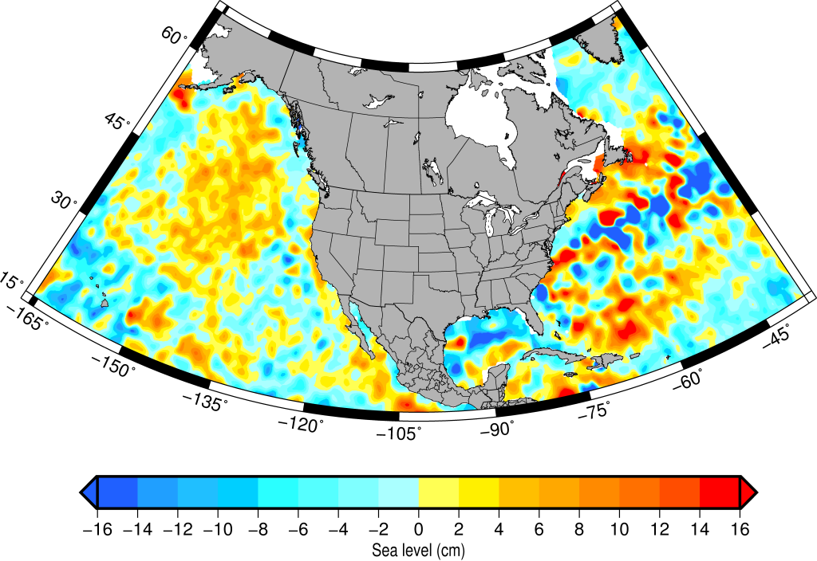
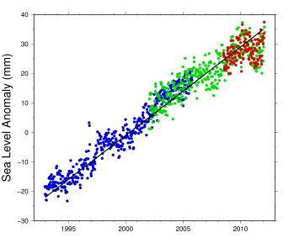
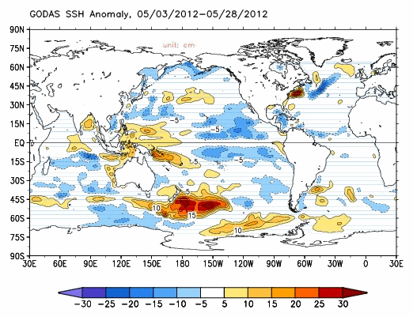
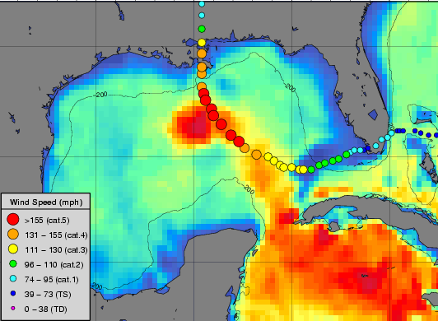
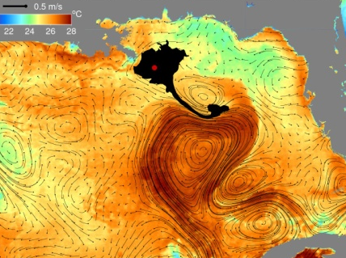

Jason Applications & End Users
Sea Level Anomaly –”Ocean Weather”- Feb 3-13, 2014
High Wave Forecasting
Coast Guard Search & Rescue
Global & Regional Sea Level Rise
El Nino Forecasting
Hurricane Intensity Forecasting
Oil Spill Monitoring

Slide 18
Harmful Algal Blooms – Operational Monitoring and Forecasting
Gulf of Mexico: South Florida
“cloud coverage has obscured recent satellite imagery, limiting analysis”
NOAA/NOS - http://tidesandcurrents.noaa.gov/hab/

Slide 19
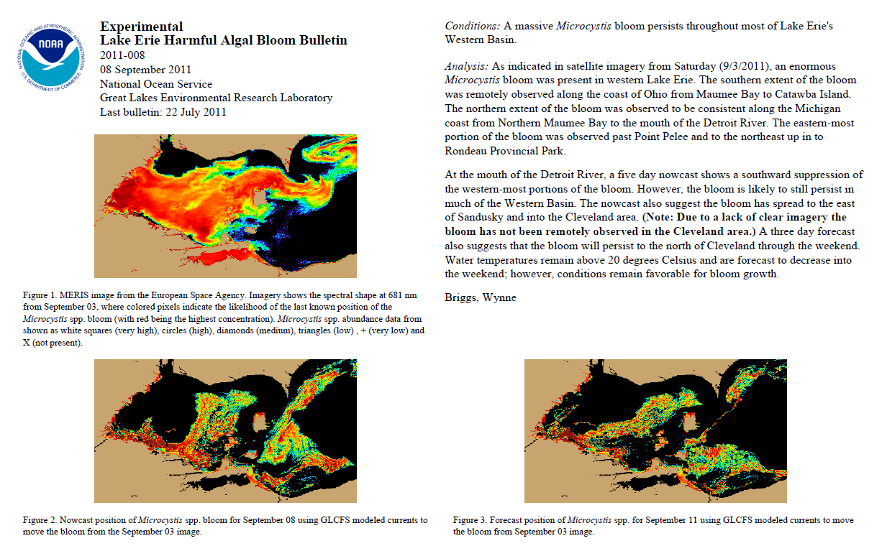

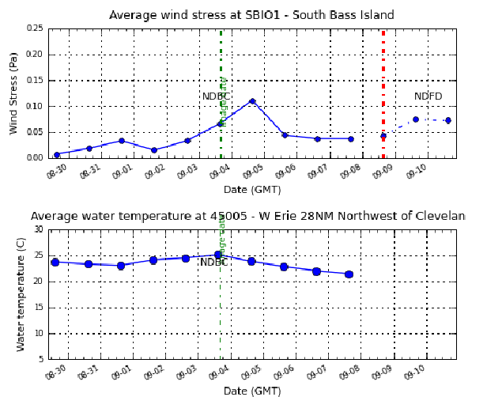
Weekly Lake Erie Bulletin: MERIS 2009-2011
Bloom from MERIS
Forecast (with Great Lakes CFS)
Notes:
NOAA National Centers for Coastal Ocean Science have produced a bulletin on location and three day forecast of the cyanobacteria blooms at the end of each week.

Slide 20
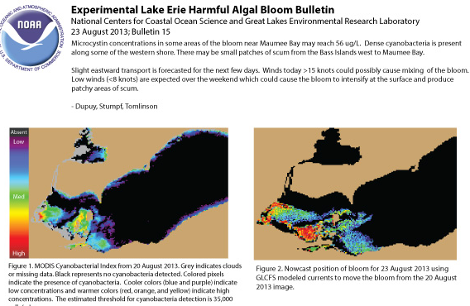
Weekly Bulletin Switch to MODIS for 2012-2013
2012 (and 2013) Bulletins: MERIS data stopped, shifted to MODIS.
Impact: Loss of resolution, MODIS is noisier and less sensitive. But MODIS algorithm is equivalent to MERIS.
Transports with the NOAA Great Lakes Coastal Forecast System
Over 700 subscribers to bulletin

Slide 21
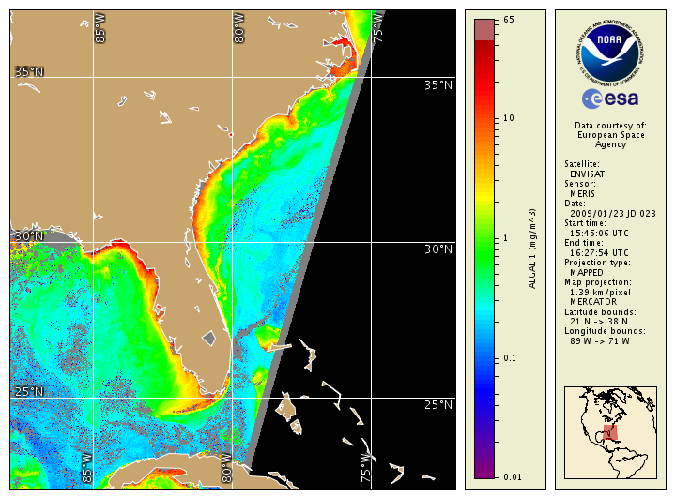
Transition of Envisat/MERIS Ocean Color Products to Operations; A Look Ahead to Sentinel-3/OLCI Data
MERIS data declared operational by NESDIS in Jan 2009; however, Envisat failed in 2012.
Chlorophyll-a/anomalies were generated from MERIS amongst other ocean color products, supporting NOS et al. users
Coastwatch/NOAA was a “Champion User” for the ESA Coast Colour Project, whose aim was to support coastal users internationally.
STAR and others in NESDIS are now actively working to facilitate acquisition of the follow-on Sentinel-3 (OLCI et al.) data to support NOAA and other U.S. user needs.
Sentinel-3/OLCI, like Envisat/MERIS, provides higher spatial resolution (300 m) than VIIRS, useful for coastal/inland waters, and also has additional spectral bands – and as such is a vital complementary capability.
STAR is supporting ESA/EUMETSAT as part of the Sentinel-3 Validation Team (3 projects)
http://coastwatch.noaa.gov
STAR’s efforts have resulted in the generation and flow of NOAA experimental and operational ocean color products to the Coastwatch user community.

Slide 22
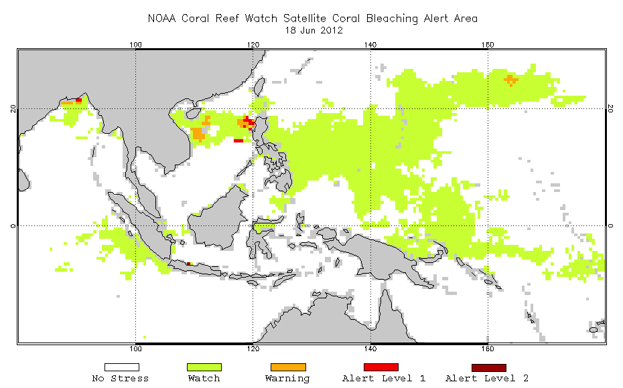
  NOAA Coral Reef Watch: http://coralreefwatch.noaa.gov/

Slide 23
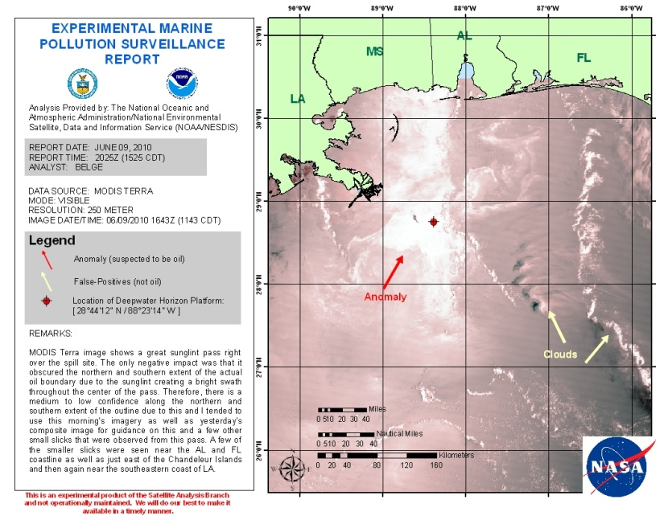
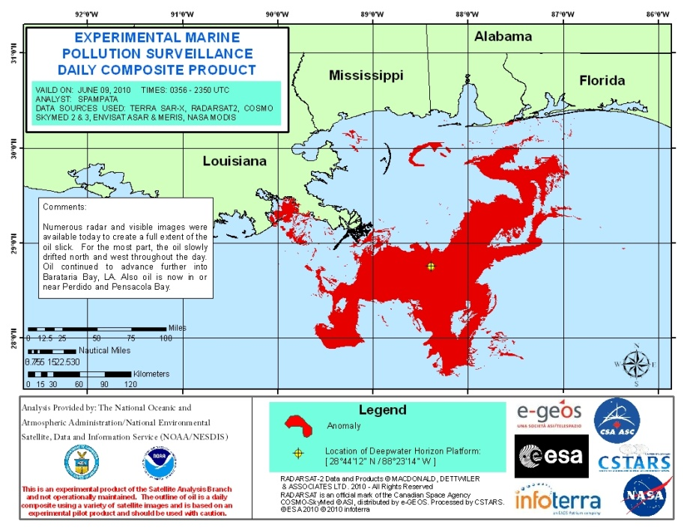
NOAA-NESDIS Satellite Analysis Branch DWH Oil Spill Products, 9 June 2010
MODIS-Terra
Composite using SAR and sun-glint imagery

Slide 24
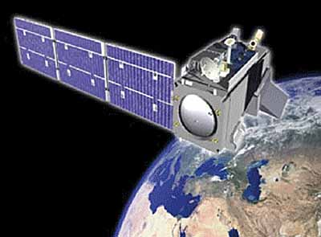
“Operational”
What does it mean?
relating to, or based on operations
ready for, or in a condition to undertake, a destined function
- Merriam-Webster’s Dictionary
Strict definition is vague at best…
• In the R2O context “operational” is often interpreted as “anything not research”.
Also rather ambiguous…
• In the world of satellite data, “operational” is often assumed to mean a near-real time (NRT) 24/7 application.
• For fisheries and marine resource managers, seasonal, interannual and decadal timescales are more relevant than NRT 24/7.
Courtesy, Cara Wilson

Slide 25
Perspectives on addressing user needs (courtesy of a NOAA line office user):

Slide 26
Perspectives on addressing user needs (courtesy of a NOAA line office user):
1. Users know what they need, but not what RS products they need.

Slide 27
Perspectives on addressing user needs (courtesy of a NOAA line office user):
1. Users know what they need, but not what RS products they need.
2. Remote sensors know what they can produce, but they don't usually know
what users need.

Slide 28
Perspectives on addressing user needs (courtesy of a NOAA line office user):
1. Users know what they need, but not what RS products they need.
2. Remote sensors know what they can produce, but they don't usually know
what users need.
3. It's easier to make an algorithm that doesn't solve a user problem than
one that does.

Slide 29
Perspectives on addressing user needs (courtesy of a NOAA line office user):
1. Users know what they need, but not what RS products they need.
2. Remote sensors know what they can produce, but they don't usually know
what users need.
3. It's easier to make an algorithm that doesn't solve a user problem than
one that does.
4. The best way to answer what users need is to work with them. Users are
friendly (usually ;)

Slide 30
Perspectives on addressing user needs (courtesy of a NOAA line office user):
1. Users know what they need, but not what RS products they need.
2. Remote sensors know what they can produce, but they don't usually know
what users need.
3. It's easier to make an algorithm that doesn't solve a user problem than
one that does.
4. The best way to answer what users need is to work with them. Users are
friendly (usually ;)
5. Most users are really polite when they are not going to use your product.
Don't confuse this with interest.

Slide 31
Perspectives on addressing user needs (courtesy of a NOAA line office user):
1. Users know what they need, but not what RS products they need.
2. Remote sensors know what they can produce, but they don't usually know
what users need.
3. It's easier to make an algorithm that doesn't solve a user problem than
one that does.
4. The best way to answer what users need is to work with them. Users are
friendly (usually ;)
5. Most users are really polite when they are not going to use your product.
Don't confuse this with interest.
6. When they keep asking you for the product, or when they offer to commit
their own time or find money to help with it, THEN you've created
something useful.

Slide 32
Perspectives on addressing user needs (courtesy of a NOAA line office user):
1. Users know what they need, but not what RS products they need.
2. Remote sensors know what they can produce, but they don't usually know
what users need.
3. It's easier to make an algorithm that doesn't solve a user problem than
one that does.
4. The best way to answer what users need is to work with them. Users are
friendly (usually ;)
5. Most users are really polite when they are not going to use your product.
Don't confuse this with interest.
6. When they keep asking you for the product, or when they offer to commit
their own time or find money to help with it, THEN you've created
something useful.
7. When managers find the products useful for solving tough problems,
researchers have the opportunity to do some really interesting science.

Slide 33
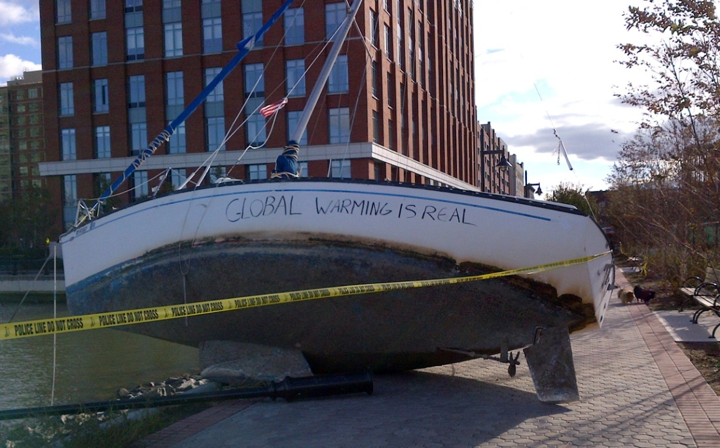
Coastal Zone Community of Practice (CZCP)‏
The Coastal Zone Community of
Practice (CZCP) supports GEO in
its goal to provide timely observations
providing services and informing
decisions concerning the coastal zone.
High priorities for GEOSS coastal
users currently include:
=> Improved forecasts of sea-level
rise and associated increase in
frequency and extent of coastal
inundation
=> Tracking changes in water quality
and ecosystem health and
productivity and ability to provide
important goods and services.
Aftermath of Super Storm Sandy, 2012
(Courtesy M. Bruno)

Slide 34
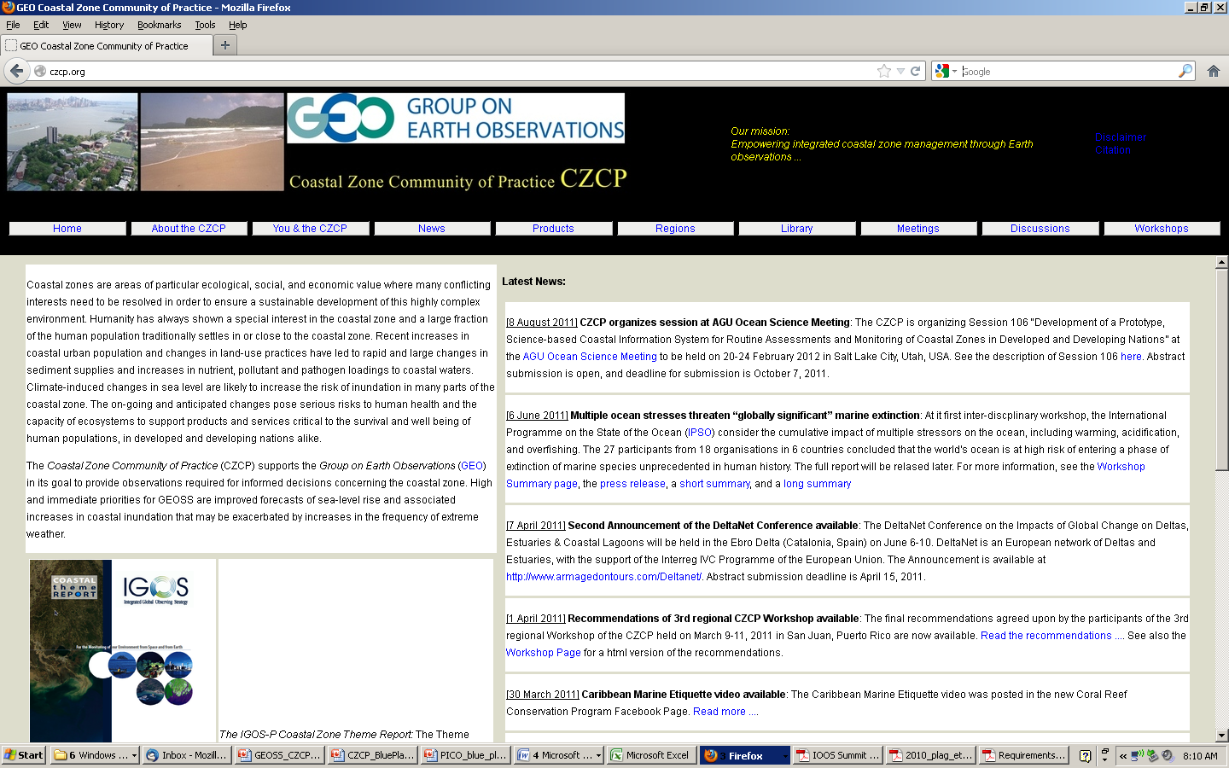
Coastal Zone Community of Practice website: http://czcp.org/ ‏

Slide 35
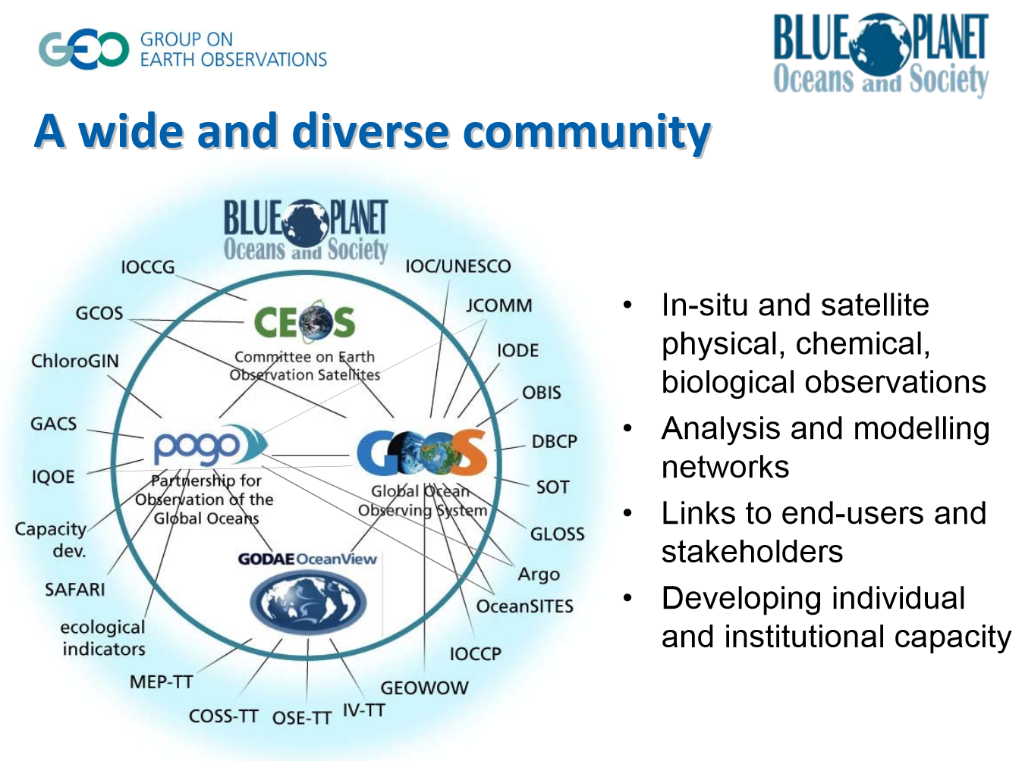
GEO 2012-2015 Workplan Task SB-01 Oceans and Society: Blue Planet

Slide 36
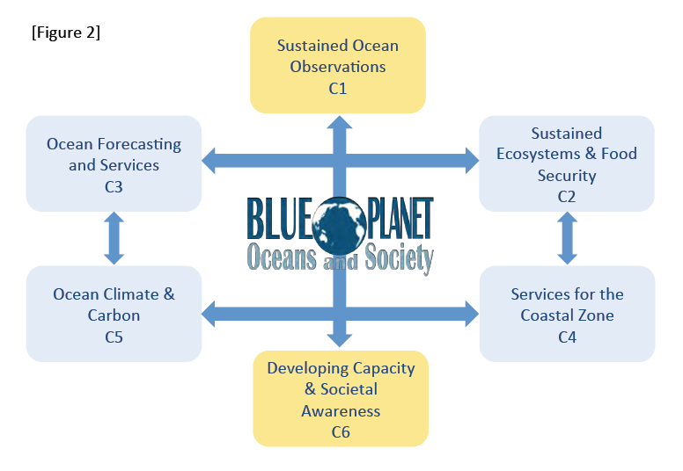
http://www.oceansandsociety.org/files/white-paper.pdf

Slide 37
C4 Services for the Coastal Zone
Leads: USA (NOAA) and IEEE (hpplag@odu.edu)
Priority Actions
• Develop a global coastal zone information system (GCZIS): a global cyber-
infrastructure that will provide access to available information on coastal zones
and facilitate the collection of new information through crowd-sourcing and
citizen-science
• Implement a pilot project in an area-at-risk to demonstrate the added-value
of ecosystem-based approaches for monitoring and managing the coastal
zone. This will be coordinated with GOOS Regional Associations and
global/regional networks (see Plan of the Panel for Integrated Coastal
Observations)
• Assess user needs and observational requirements for coastal water quality
(using the GEOSS User Requirements Registry); identify indicators and best
practices for coastal water quality, and implement a monitoring service pilot
for coastal water quality (with WA-01 and HE-01); disseminate information
particularly to under-served communities (with IN-04)

Slide 38
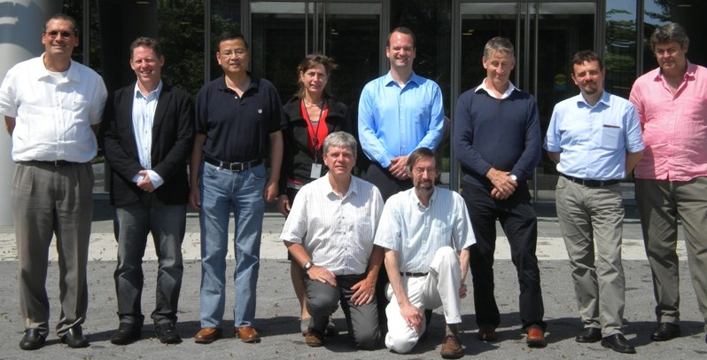
International Ocean Colour Coordinating Group (IOCCG) Working Group:
Earth Observations in Support of Global Water Quality Monitoring
Working group participants at the NOAA/National Center for
Weather and Climate Prediction, College Park, MD, USA

Slide 39
International Ocean Colour Coordinating Group (IOCCG) Working Group:
Earth Observations in Support of Global Water Quality Monitoring
Working group participants at the NOAA/National Center for
Weather and Climate Prediction, College Park, MD, USA
Now working to develop broader Water Quality Community of Practice
(WQ-CoP) under the auspices of GEOSS and CEOS

